Slide 1
Development of master curricula for natural disasters risk management in Western Balkan countries
How to improve quality of promotions of trainings (LLL courses) and students enrolment – EU experience
Gabriella Farkas
Óbuda University, Donát Bánki Faculty of Mechanical and Safety Engineering
Fifth Quality Assurance Committee meeting/ 20th March 2019
Project number: 573806-EPP-1-2016-1-RS-EPPKA2-CBHE-JP
"This project has been funded with support from the European Commission. This publication reflects the views only of the author, and the Commission cannot be held responsible for any use which may be made of the information contained therein"

Slide 2
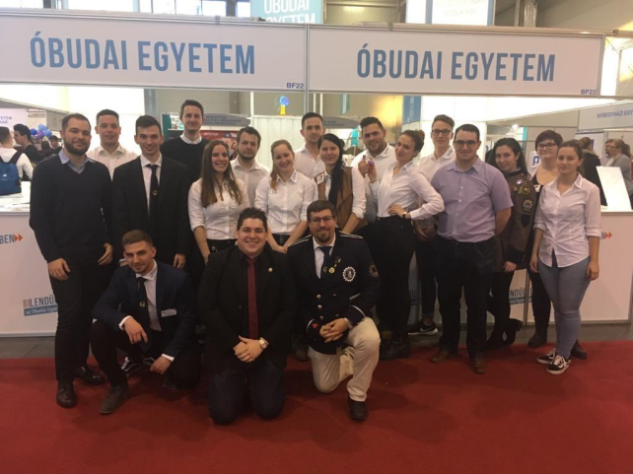
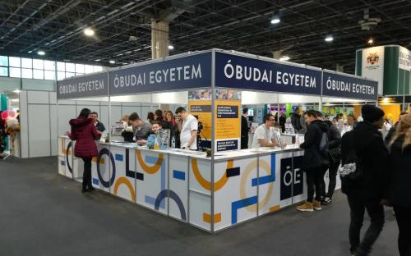
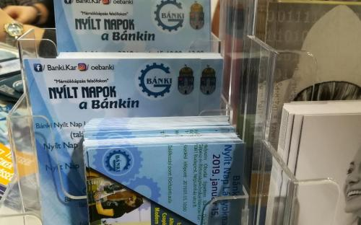
How to improve quality of promotions of students enrolment?
Development of master curricula for natural disasters risk management in Western Balkan countries
International Education Expo
Faculty
Trainings
Career
Industry parties
Date: 10-12. January 2019.
Venue: HUNGEXPO (Budapest)
Participants:
Students, teachers, parents (more than 53,000 visitors)

Slide 3
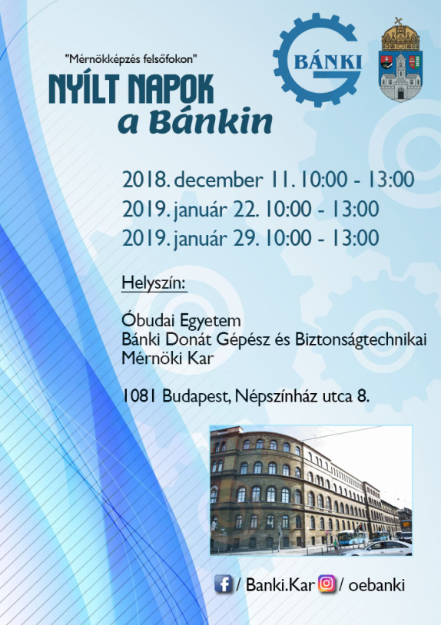
How to improve quality of promotions of students enrolment?
Development of master curricula for natural disasters risk management in Western Balkan countries
Open days
Introduction of the Banki Faculty
Student life
Lab visits
Date: from December to February
Venue: ÓE BGK (Bp., Népszínház str.), ÓE (Bp., Bécsi str.)
Participants:
Students from High schools

Slide 4
How to improve quality of promotions of students enrolment?
Development of master curricula for natural disasters risk management in Western Balkan countries
Open Day for Girls
Successful women at Banki Faculty
Student life
Lab visits
Date: 15. January 2019.
Venue: ÓE BGK (Bp., Népszínház str.)
Participants:
Special offer for female students from High schools

Slide 5
How to improve quality of promotions of students enrolment?
Development of master curricula for natural disasters risk management in Western Balkan countries
Researchers’ night
~ 5000 visitors
170 programs
Budapest, Salgótarján, Székesfehérvár
Date: 27. September 2019.
Venue: All Campuses of Óbuda University
Participants:
Free for all people

Slide 6
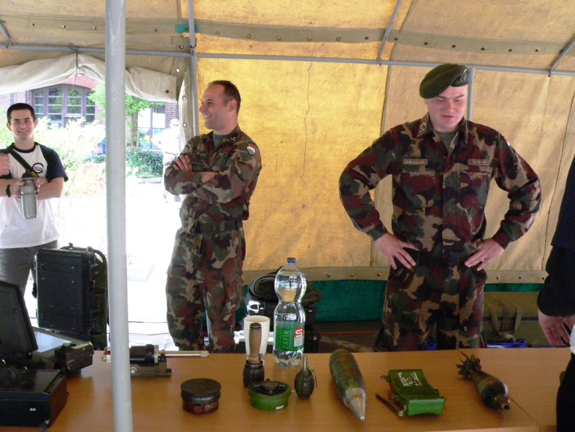
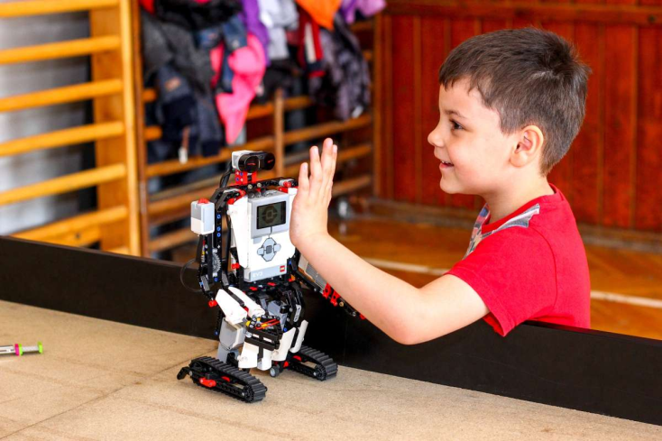
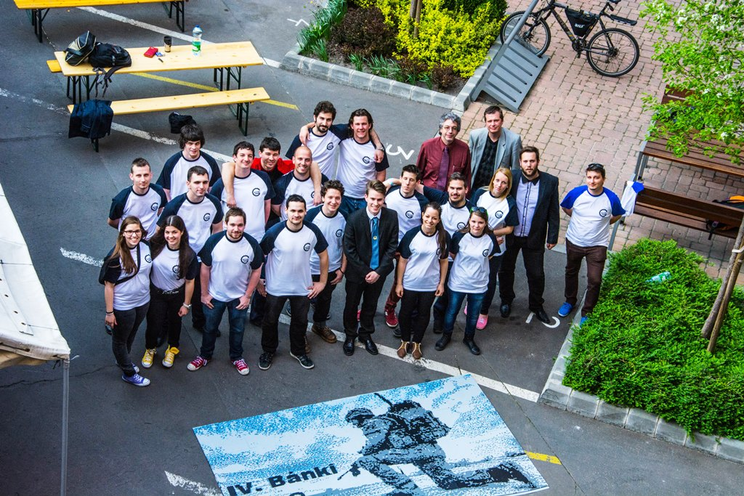
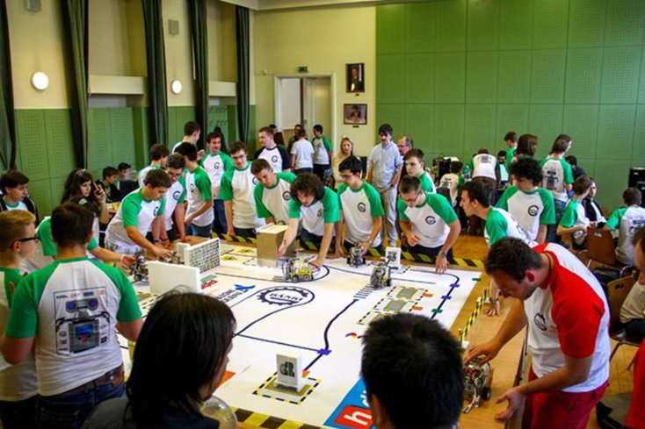
How to improve quality of promotions of students enrolment?
Development of master curricula for natural disasters risk management in Western Balkan countries
Special events - LEGO Day

Slide 7
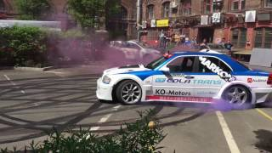
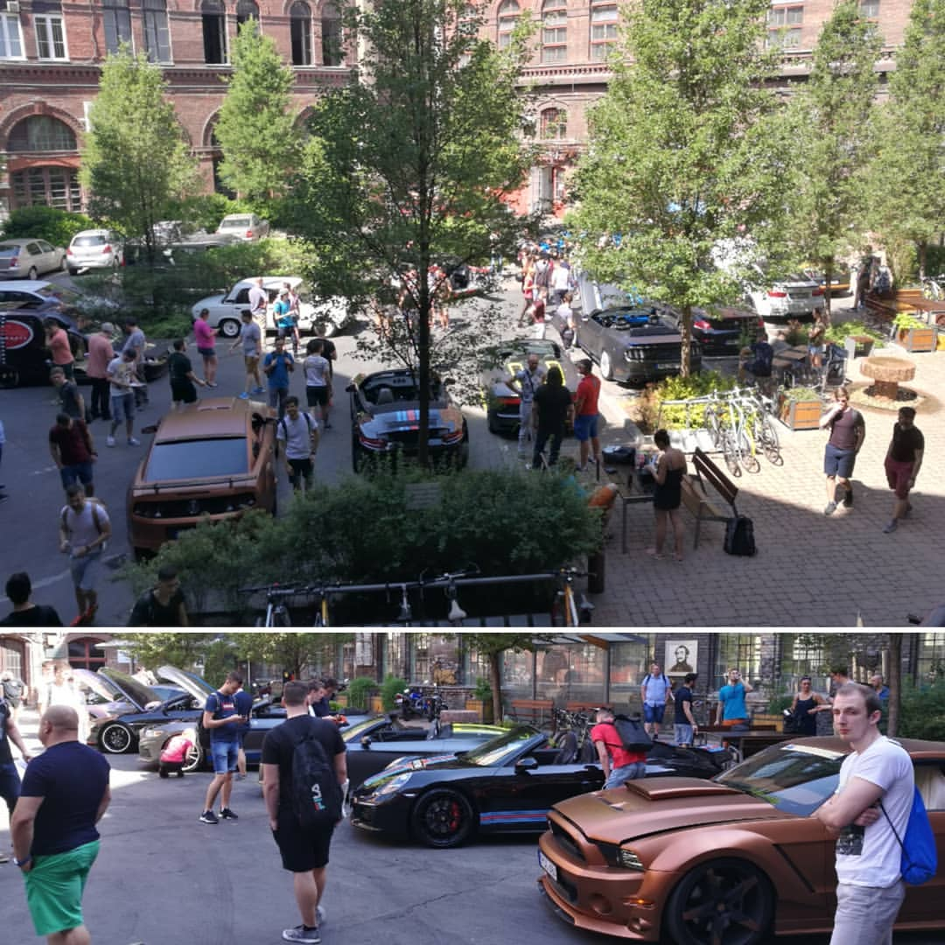
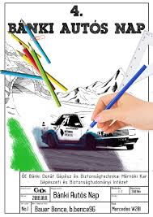
How to improve quality of promotions of students enrolment?
Development of master curricula for natural disasters risk management in Western Balkan countries
Special events – Cars’ Day

Slide 8
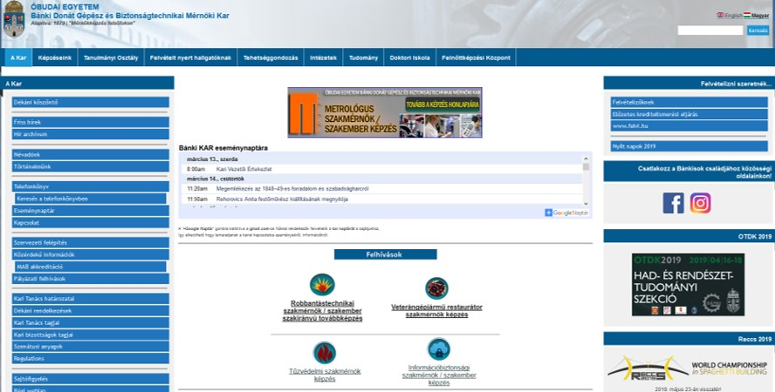
How to improve quality for promotion of LLL?
Development of master curricula for natural disasters risk management in Western Balkan countries
Adult training centre at Banki
coordinates and develops activities related to adult education and further training at Banki Faculty
promotes the expansion of the training portfolio
supports the successful completion of Master courses
Its mission is to develop and operate an adult training system based on the consideration of competing needs from economic operators and the use of effective training methods for adult learners.
OFFICE
Head: Ella Dombovári, PhD
Address & Contact: A.33. Adult training centre
H – 1081 Budapest
Népszínház str. 8.

Slide 9
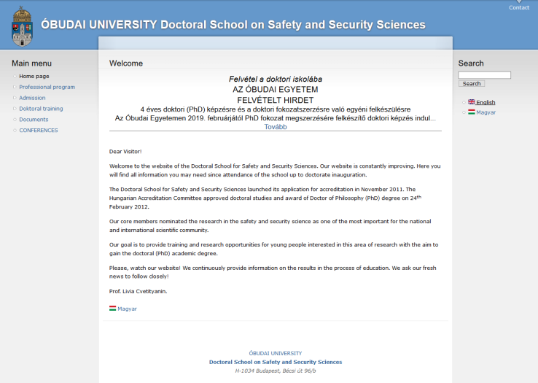
How to improve quality for promotion of LLL?
Development of master curricula for natural disasters risk management in Western Balkan countries
Doctoral School on Safety and Security Sciences
Our goal is to provide training and research opportunities for young people interested in this area of research with the aim to gain the doctoral (PhD) academic degree.
OFFICE
Head: Lívia Cvetityánin PhD
Address & Contact: F. 15. Office of Doctoral School on Safety and Security Sciences
H – 1081 Budapest
Népszínház str. 8.

Slide 10
How to improve quality of promotions of trainings and students enrolment- EU experience
Development of master curricula for natural disasters risk management in Western Balkan countries
Thank you for your attention!

